Slide 1
The cell biology lab 13
Cell culture techniques

Slide 2
Cell culture: is the process by which prokaryotic, eukaryotic or plant cells are grown under controlled conditions.
Cell culture refers to the removal of cells from an animal or plant and their subsequent growth in a favorable artificial environment.

Slide 3
The cells may be removed from the tissue directly and disaggregated by enzymatic or mechanical means before cultivation, or they may be derived from a cell line or cell strain that has already been already established.

Slide 4
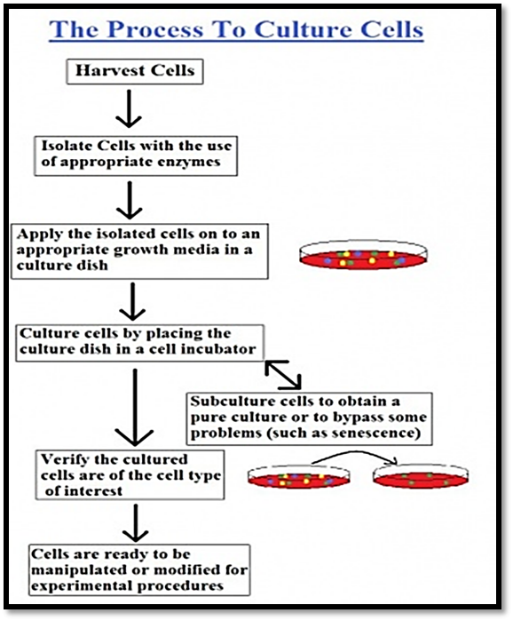

Slide 5
The morphology of Cells in Culture
The cells in culture can be divided in to three basic categories based on their shape and appearance (i.e., morphology):
1- Fibroblastic (or fibroblast-like): cells are bipolar or multipolar, have elongated shapes, and grow attached to a substrate.
2- Epithelial-like: cells are polygonal in shape with more regular dimensions, and grow attached to a substrate in discrete patches.
3- Lymphoblast-like: cells are spherical in shape and usually grown in suspension without attaching to a surface.

Slide 6
((Culture Conditions))
The culture conditions are vary widely for each cell type, but the artificial environment in which the cells are cultured invariably consists of a suitable vessel containing the following:
1- A substrate or medium that supplies the essential nutrients (amino acids, carbohydrates, vitamins, minerals).
2- Growth factors.
3- Hormones.
4- Gases (O₂ , CO₂).
5- A regulated physico-chemical environment (pH, osmotic pressure, temperature).

Slide 7
((Types of cell culture))
1- Primary cell culture: This is the maintenance of growth of cells dissociated from the parental tissue (such as kidney or liver). The primary cell culture could be of two types depending upon the kind of cells in culture:
A. Adherent cells: are usually derived from tissues of organs such as kidney where they are immobile and embedded in connective tissue.
B. Suspension cells: are derived from cells of the blood system because these cells are also suspended in plasma in vitro e.g. lymphocytes.
2- Secondary cell cultures: When a primary culture is sub-cultured, it becomes known as secondary culture or cell line. The process involves removing the growth media and disassociating the adhered cells (usually enzymatically).

Slide 8
((Applications of Cell Culture))
1- Providing excellent model systems for studying the normal physiology and biochemistry of cells.
2- Studying the effects of drugs and toxic compounds on the cells, and mutagenesis and carcinogenesis.
3- Used in drug screening and development, and large scale manufacturing of biological compounds (e.g., vaccines, therapeutic proteins).

